Slide 1
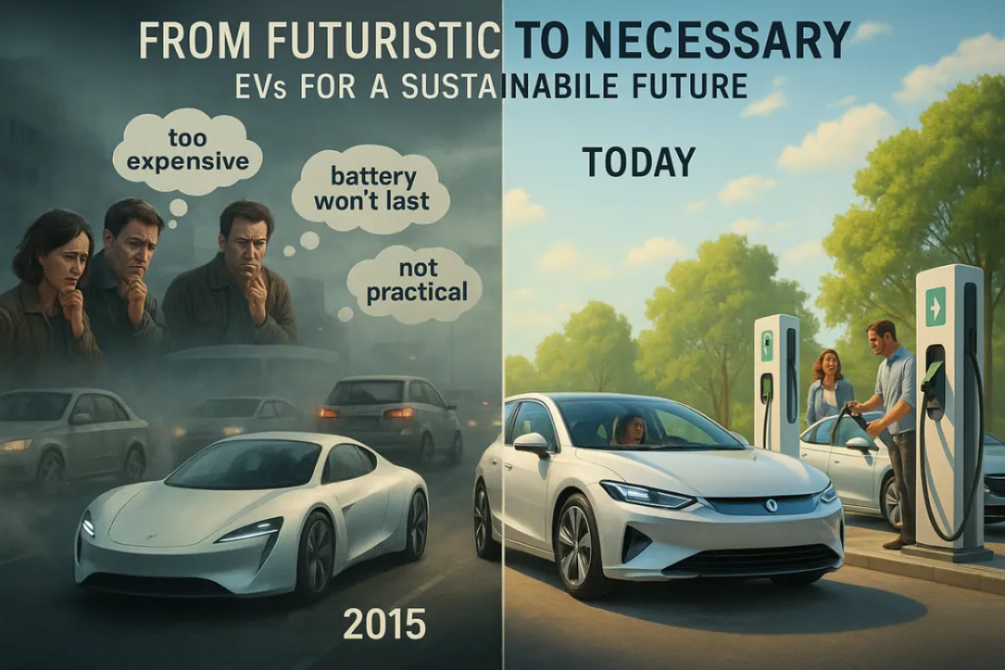

Slide 2
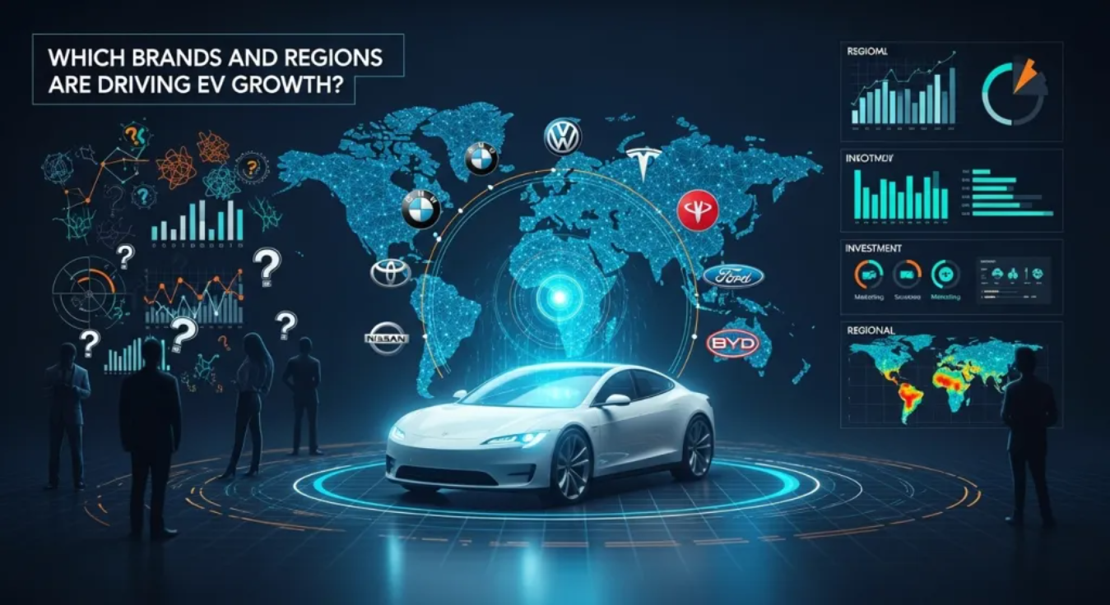
“As more companies enter the EV market, stakeholders face a big question: Which brands and regions are driving growth, and where do we need to improve? Without clear insights, it’s difficult to plan investments, production, and marketing strategies.”

Slide 3

Electric Vehicle Sales Analysis
Comprehensive Market Intelligence Report

Slide 4
Project Overview
Project Title: Electric Vehicle Sales Analysis
Overview:
This comprehensive Electric Vehicle Analysis Dashboard provides strategic insights into the global EV market performance across multiple dimensions. The project analyzes 3,000 vehicles sold generating $66.67M in total revenue and detailed performance metrics across 10 major automotive Company. And analyze sales, revenue, battery performance, market trends, and environmental impact of electric vehicles to support strategic decision-making.

Slide 5
Project Objectives
Sales & Revenue Trends → Identify top and flop brands.
Battery Performance → Track average battery health and efficiency over time.
Environmental Impact → Evaluate CO₂ savings by company.
Market Trends by Region & Usage → Understand customer adoption patterns.
Vehicle Performance Comparison → Assess acceleration, charging time, range, and energy consumption.
Pricing Insights → Highlight top expensive and low-cost EV models.

Slide 6
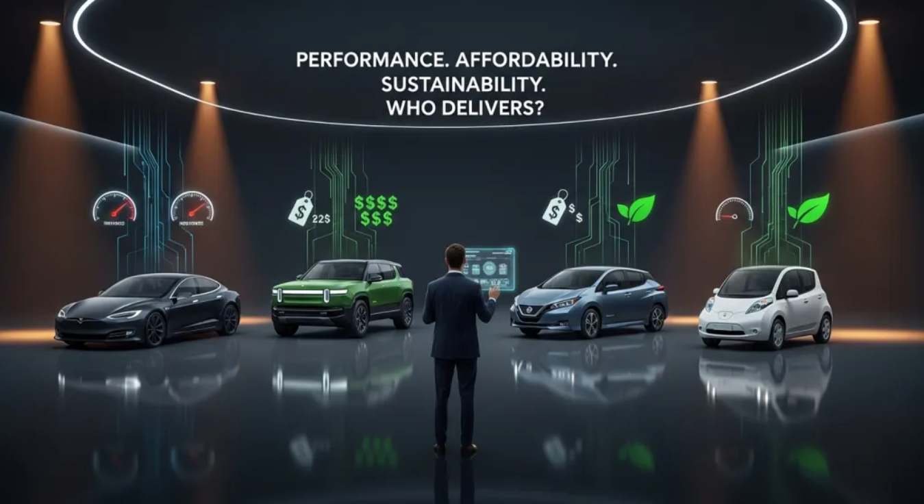

Slide 7
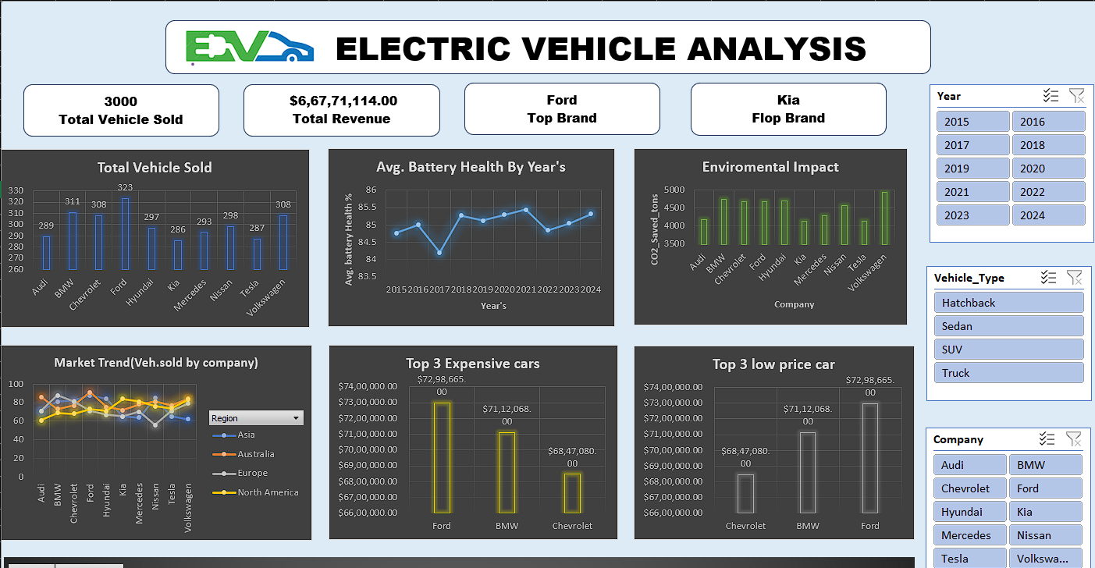
Dash Board

Slide 8
KPIs(Key Performance Indicators)
3000
$66,671,114
Ford
kia
Total Vehicle Sales
Total Revenue
Market Leader
Market Laggard

Slide 9
Analysis with Strategic Solutions
1. Sales Volume Optimization
Current State: Ford leads with highest sales volume
Challenge: Kia significantly underperforming in market penetration
Solution:
  Implement targeted marketing campaigns for underperforming brands
  Analyze Ford's success factors and replicate across portfolio
  Focus on regional expansion in high-potential markets
2. Revenue Enhancement
Current State: $66.67M total revenue generated
Opportunity: Premium pricing strategy showing strong results
Solution:
  Develop tiered pricing models for different market segments
  Focus on high-value vehicle categories (SUV/Truck segments)
  Implement dynamic pricing based on regional demand

Slide 10
3. Technical Performance Improvement
Current State: Battery health averaging 85.5% with declining trend
Challenge: Battery degradation impacting long-term value proposition
Solution:
  Invest in next-generation battery technology
  Implement predictive maintenance programs
  Develop battery health monitoring systems
4. Market Share Expansion
Current State: Regional performance varies significantly
Opportunity: North America and Europe showing strong growth
Solution:
  Localize product offerings for regional preferences
  Establish strategic partnerships in emerging markets
  Develop region-specific charging infrastructure

Slide 11
Performance Analysis
The dashboard reveals significant performance variations across manufacturers:
Acceleration Performance: Consistent 6.6-6.8 second range across brands
Battery Health: Slight variations (84-86%) indicating similar technology maturity
Range Capabilities: Competitive parity with 360-380km average range
Battery health from 2015-2024 show:
Initial improvement from 2015-2019
Peak performance around 2019-2020
Slight decline in recent years requiring attention

Slide 12
Immediate focus on battery health optimization
Leverage Ford's success model for other brands
Implement dynamic pricing strategies
Regional expansion opportunities
Strategic recommendations

Slide 13
Conclusion
The Electric Vehicle Analysis Dashboard demonstrates a robust market position with strong revenue generation and balanced brand performance. Key success factors include maintaining technical excellence while addressing specific challenges in battery health and brand-specific performance gaps. The data supports continued investment in the EV sector with strategic focus on market expansion and technology advancement.

Slide 14
Thank You…

